Slide 1
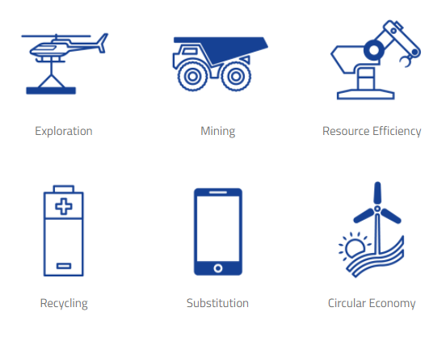
EIT RAW MATERIALS

Slide 2
EIT JUMSTARTER EIT Jumpstarter is a pre-accelerator program for innovators in the healthcare, agri-food, raw materials, energy, urban mobility and manufacturing industries.
Phase 1: Submission of ideas
Rok za oddajo prijave: 16.4.2021 do 23:59
Rezultati znani do 16.5.2021
Phase 2: Boot Camp and Coaching (junij)
Phase 3: Local Joint Trainings (september)
Phase 4: Mentoring and Final Pitching (november)
Nagrade: 1. mesto: 10.000€; 2. mesto: 7.000€, 3.mesto: 5.000€

Slide 3
EIT RAWMATERIALS ACCELERATOR
Phase 1: Explore
Rok za oddajo prijave: 3.3.2021 do 23:59
This call is for start-ups who consider that they already have an innovative offering (at TRL 4-6) – and who see an opportunity in rapidly developing this offering to the exploration, mining, mineral processing, metal & mineral, steel-making and recycling industries as well as suppliers of equipment and tools to these industries.
Funding: 15.000€
Trajanje: 3 mesece

Slide 4
EIT RAWMATERIALS ACCELERATOR
Phase 2: Build
The purpose of Phase 2 is to validate customer needs and verify business assumptions. The offering provided by the selected start-ups should be at TRL 5-7 and CRL 5.
Prehod iz phase 1.
Funding: 30.000€
Trajanje: 6 mesecev

Slide 5
EIT RAWMATERIALS ACCELERATOR
Phase 3: Grow
Phase 3 aims to get the business ready for launch. The offering of the start-ups should at the start be at a TRL 7-9 and heading for market entrance.
Prehod iz phase 2.
Funding: 45.000€
Trajanje: 6-9 mesecev

Slide 6
EIT RAWMATERIALS BOOSTER CALL
RM Booster programme provides support to start-ups and SMEs to develop innovative products and services with main focus on:
Sustainable Discovery and Supply of primary and secondary resources (innovative solutions based for example on artificial intelligence, machine learning, virtual reality etc.) for securing and processing strategic mineral resources in a sustainable and safe way and with a social license to operate.
Sustainable Materials for Future Mobility (materials for electrification such as batteries, fuel cells, magnets; materials for lightweight design including steels, non-ferrous alloys, composites, multimaterials).
Raw Materials and Circular Societies (new circular business models such as reuse, repair, remanufacturing, sharing economy).
Roki prijav: 31.3.2021, 28.5.2021, 3.9.2021
Funding: do 60.000€

Slide 7
VEČ INFORMACIJ
https://eitrawmaterials.eu/
Ksenja Jaklič
ksenja@bogatin.si
Špela Rozman Dolenc
Spela.rozman-dolenc@lui.uni-lj.si

